Slide 1


ARTIFICIAL INTELLIGENCE &MACHINE LEARNING RLVNSG SAGAR - 21BK5A6606 A AISHWARYA - 21BK5A6601 K BHUPATHI REDDY- 21BK5A6604 P VARSHITHA - 20BK1A6651 P NIKHIL - 21BK5A6605

Slide 2
PROJECT EXPO
AQUILA 2022:-
AI BASED VISION FOR BLIND PEOPLE

Slide 3
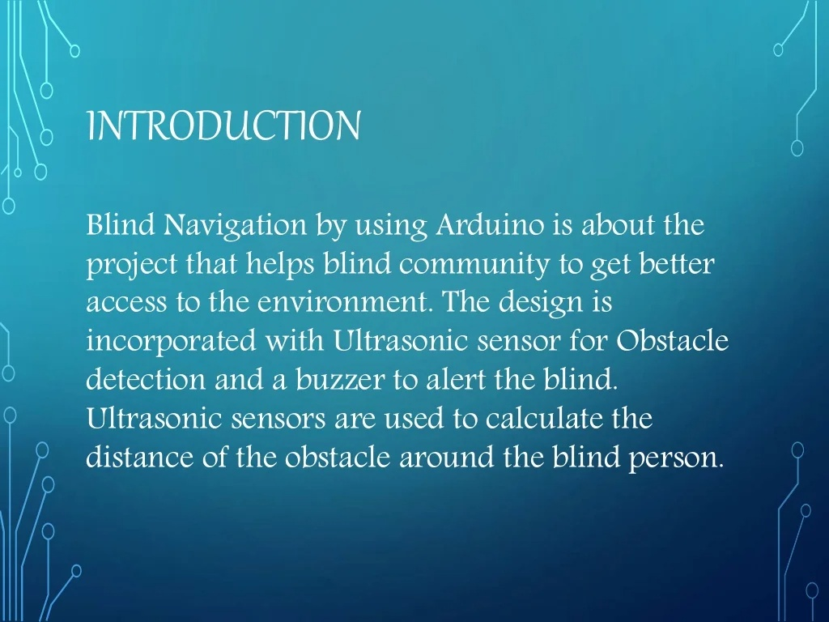

Slide 4
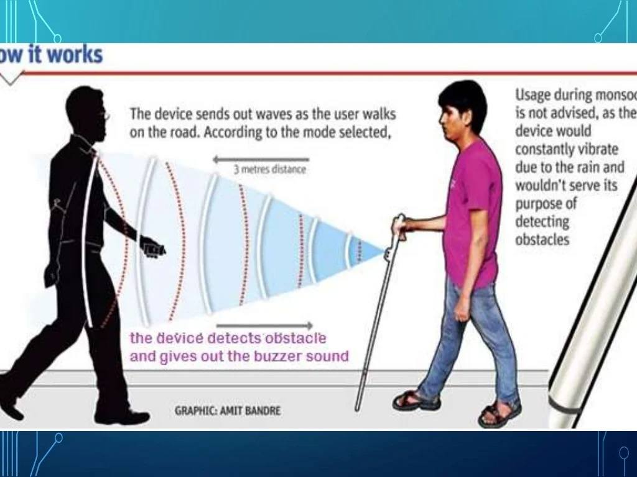

Slide 5
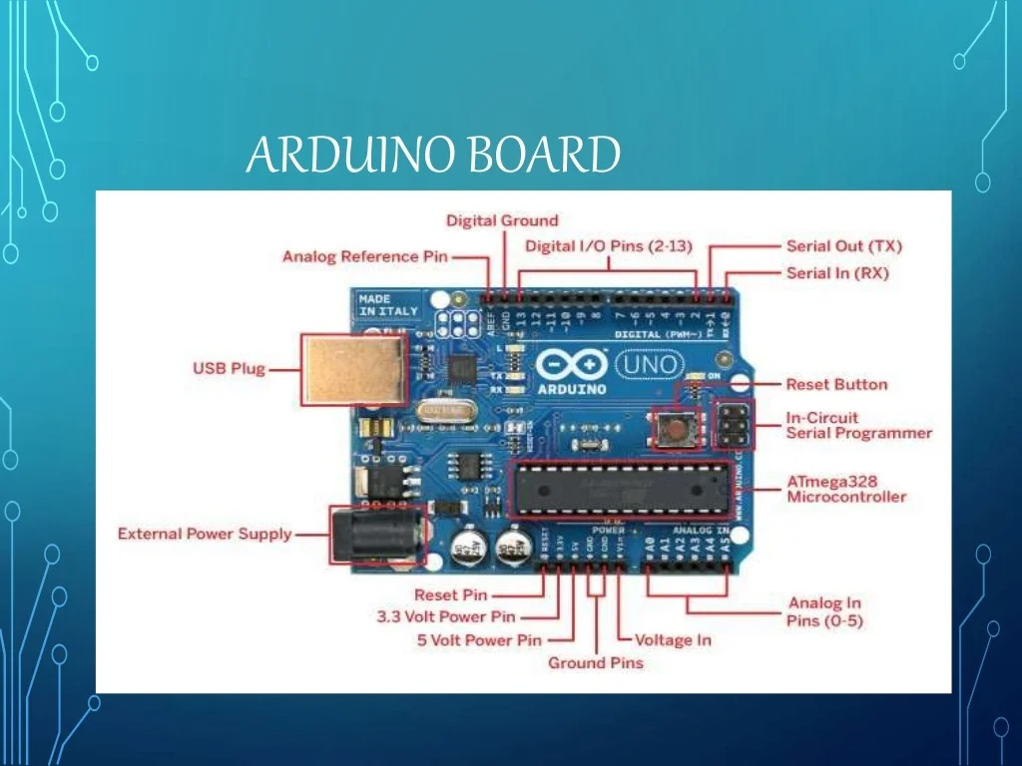

Slide 6


Slide 7
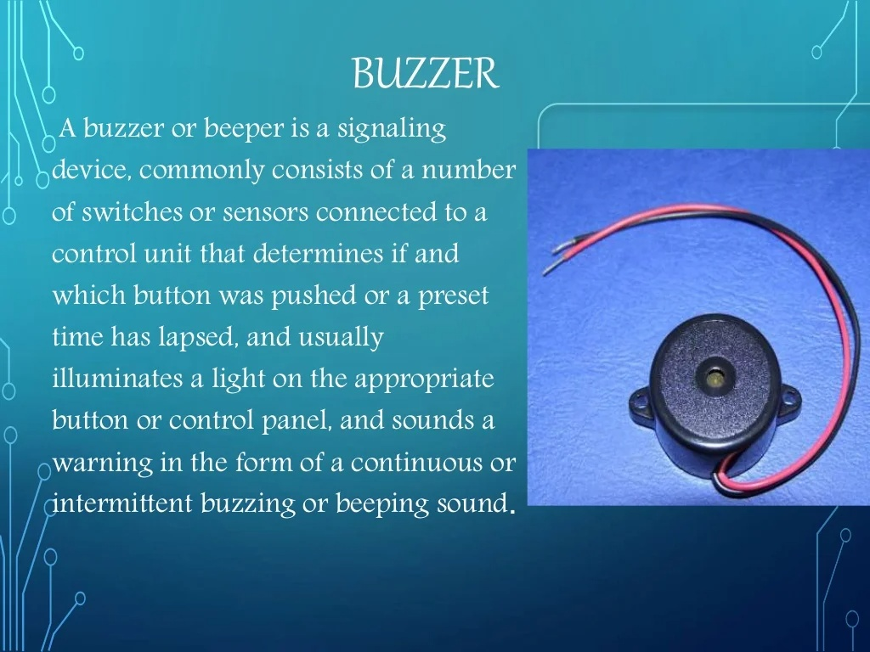

Slide 8
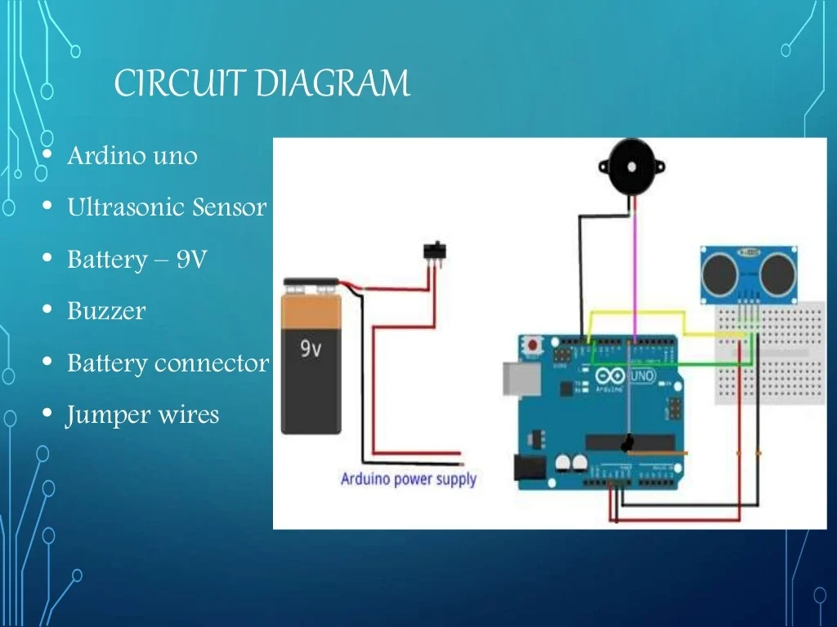

Slide 9
ADVANTAGES
The advantages of the AI based vision for blind people are can identify the object through its sensors and actuators
This project is not only helpful for blind people it is also can used by robots and security systems
The advantage of this project is low cost and durable within its segments
These are the main advantages of AI Based vision for blind people

Slide 10
Disadvantages:-
The main disadvantage of this project is the current supply and the battery source In the project
When we overcome this disadvantage the project is well and good widely useful for blind people

Slide 11
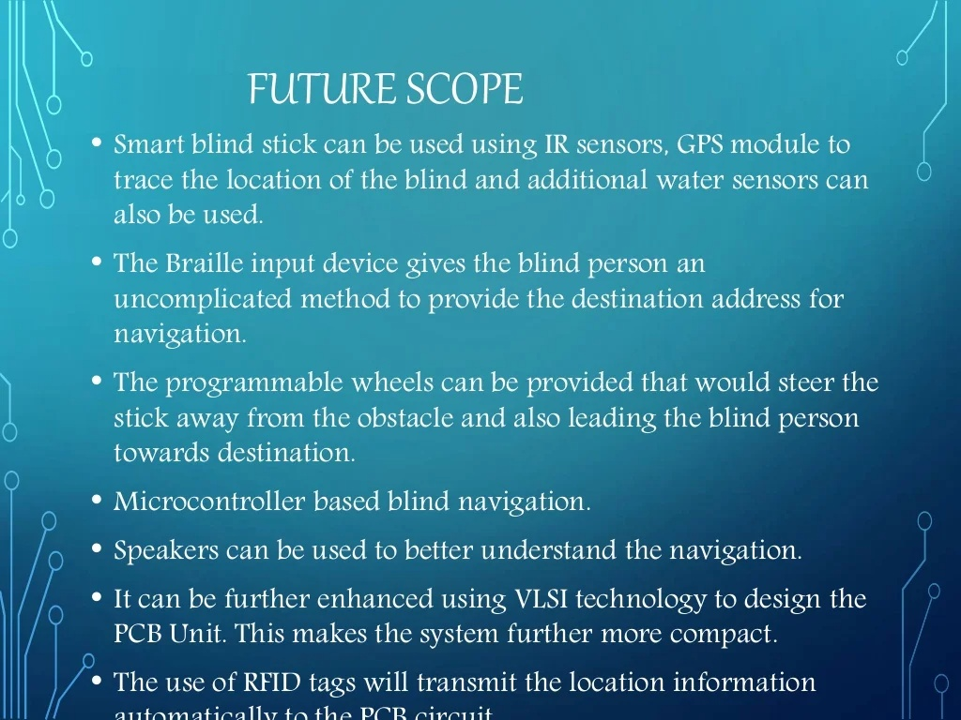

Slide 12
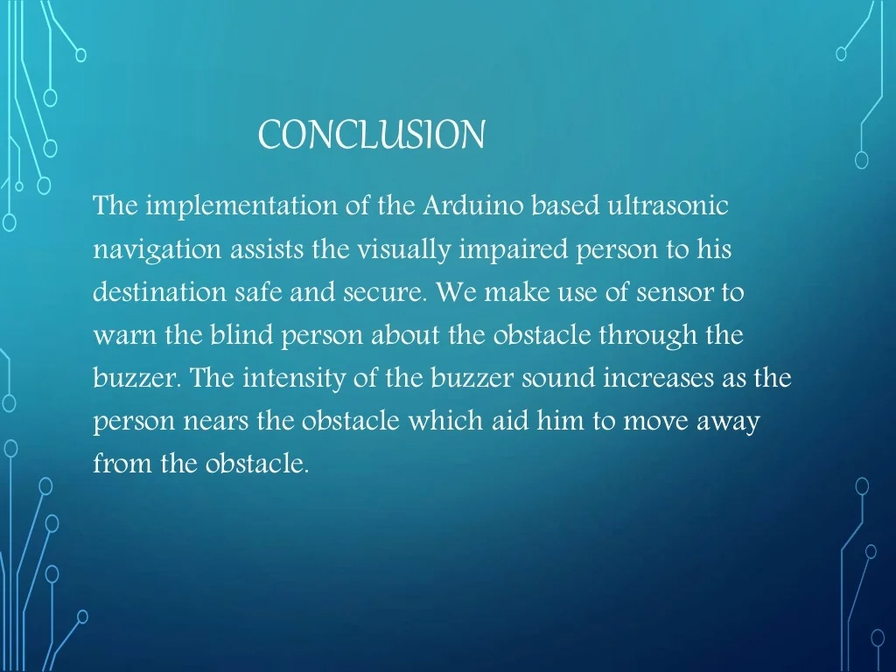

Slide 13


